Slide 1
Assignment -1

Slide 2
Business Problem:
Objective:
According to our analysis business problem is whether to prefer google camping add or facebook campings which shows the performance of different age group for different dementions.

Slide 3
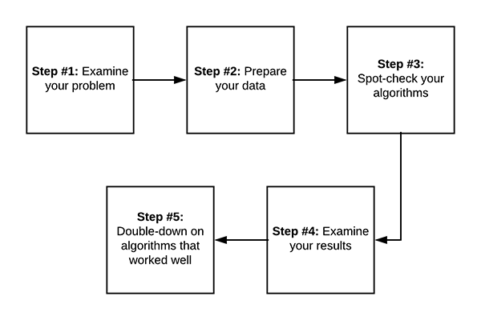
Project Architecture / Project Flow

Slide 4
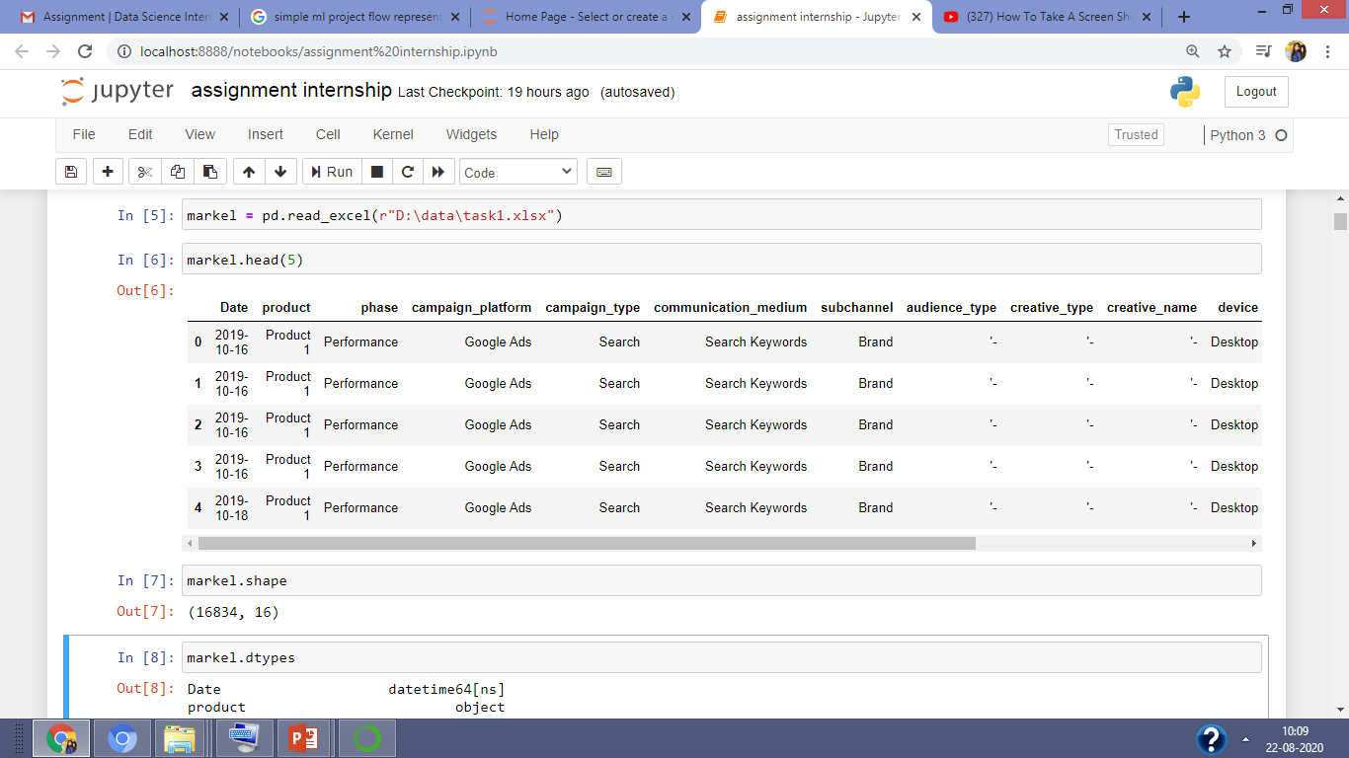
Data set details
Dataset : Marketing campings containing data from oct 19 to july 20 using facebook and google campings which shows the performance of different age group.
No of rows and column :( no of rows 16834 and no of columns 16)
Camping dataset

Slide 5
Columns name : Date, product, phase, campaign_platform, campaign_type, communication_medium, subchannel, audience_type, creative_type, creative_name, device, spends, impressions, clicks, link_clicks
Date : It represent the data collection date. It’s from October 2019 to July 2020
Product : It’s represent the product of the camping which is product 1
Phase : It represent the phase of camping which is performance
campaign_platform : It represents the platform through which we performed camping , Here camping conduct by google add or facebook add
campaign_type: It represent the type of camping. There are two type of camping
One is search and second one is conversation.
communication_medium : It represent the communication medium through which we connect with different age group people. It is two type one is creative ,second one is search keyword
Subchannel : There are 4 type of subchannel present Brand,Comprtitor,Genric,Facebook add
audience_type : Types of audience present in data. There are 4 type of audience
creative_type: There are three type of creative type to attract different age people. Creative type are
Image type,carousal
creative_name: There are 4 types of creative name ,these are caracoul,click,girl
Device: Types of device used by people. There are three type laptop, mobile, phone
Spends: spend means people pays how much time or money for camping. impressions
Impressions : impression of towars camping.
Clicks : It represent how many people used click style.

Slide 6
Exploratory Data Analysis (EDA)
Importing all the libraries what we need to work in our dataset
import numpy as np
import pandas as pd
import matplotlib.pyplot as plt
Importing our dataset into python: WE USED FOLLOWING CODE TO IMPORT OUR DATASET INTO PYTHON
markel = pd.read_excel(r"D:\data\task1.xlsx")

Slide 7
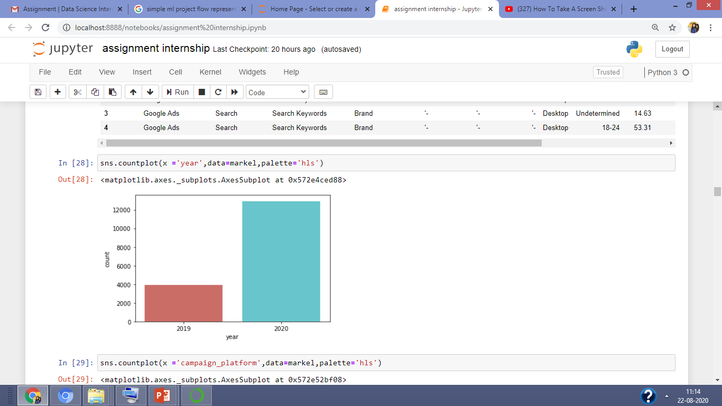
VISUALIZATION OF OUR DATA SET: This graph represent the two year present in dataset

Slide 8
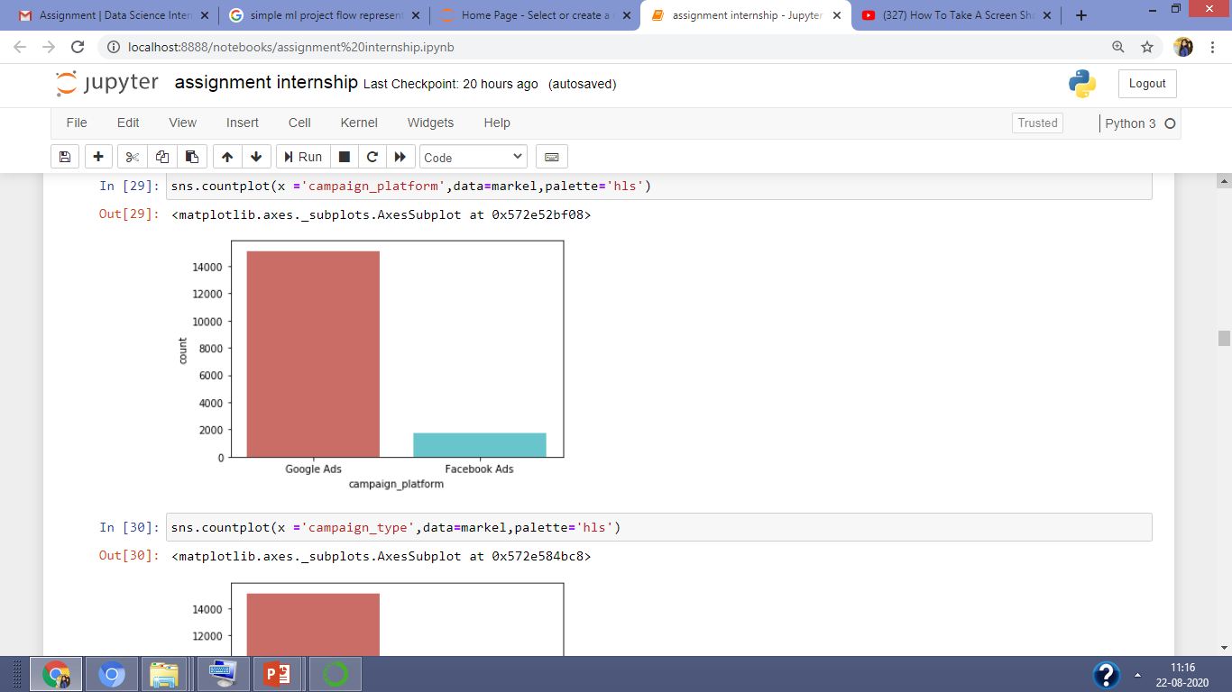
This graph represent types of camping platform present in dataset

Slide 9
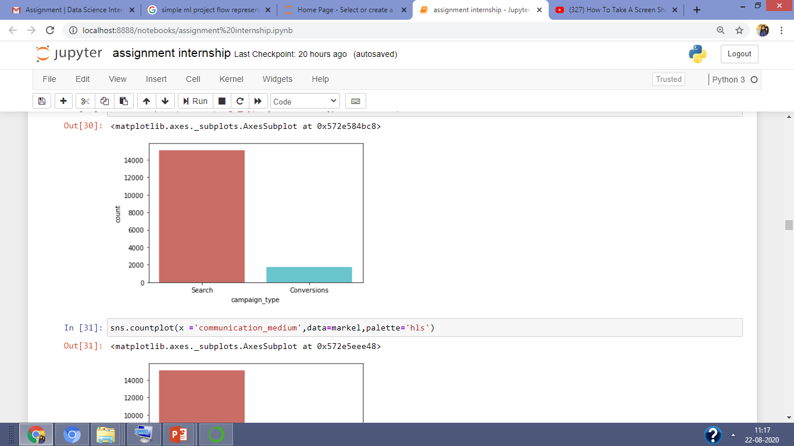
This graph represent camping type present in our dataset

Slide 10
This graph represent camping_type present in our dataset

Slide 11
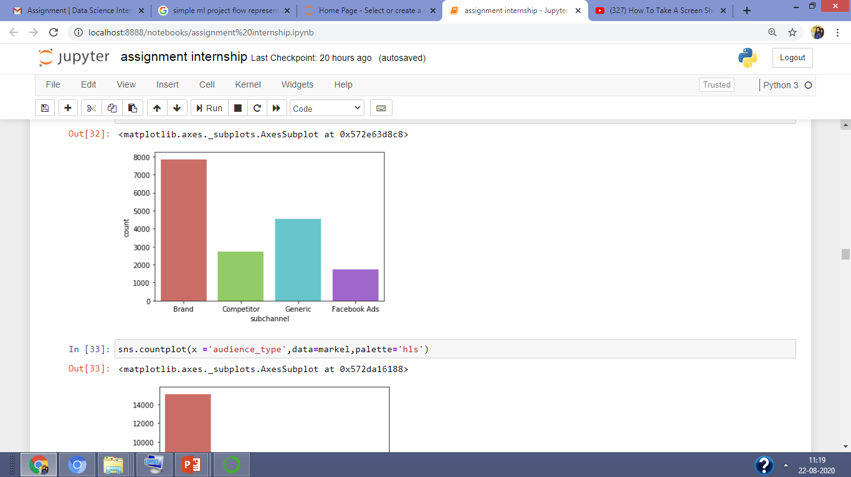
This graph represent the types of subchannel present in our dataset

Slide 12
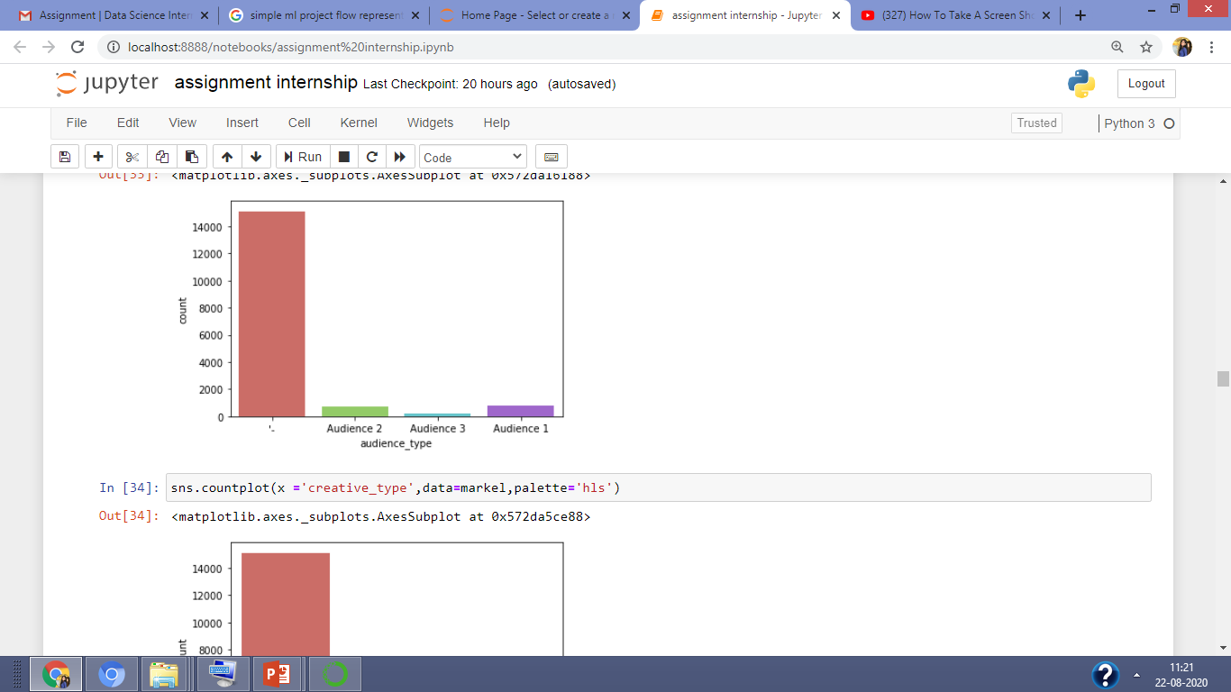
This graph represent type of audience present in dataset

Slide 13
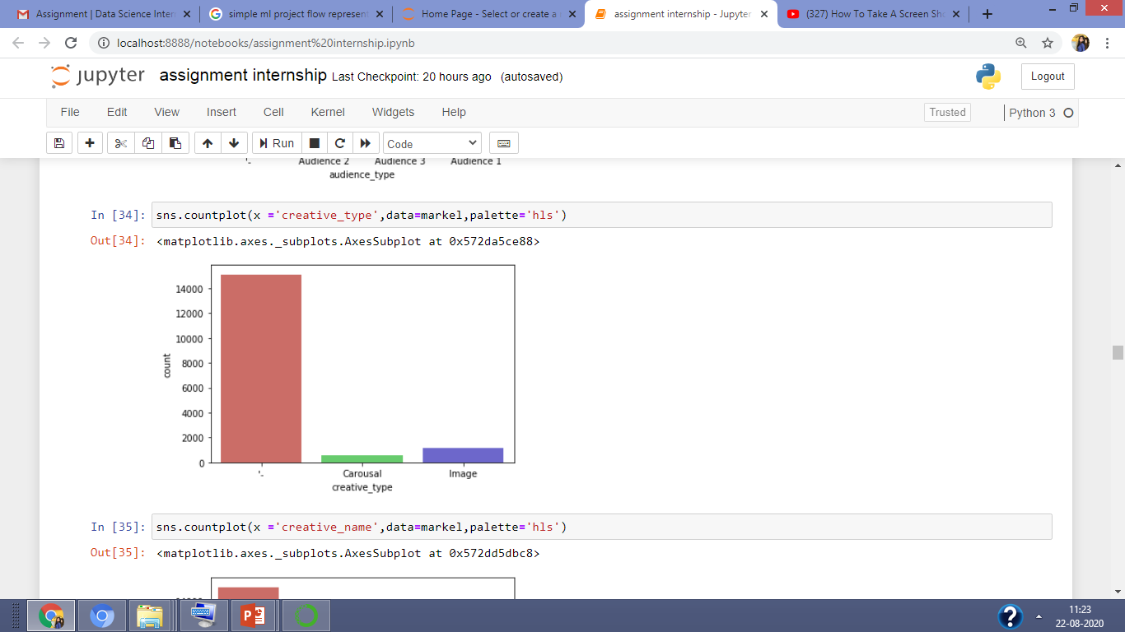
This graph represent types of creative idea present in camping

Slide 14
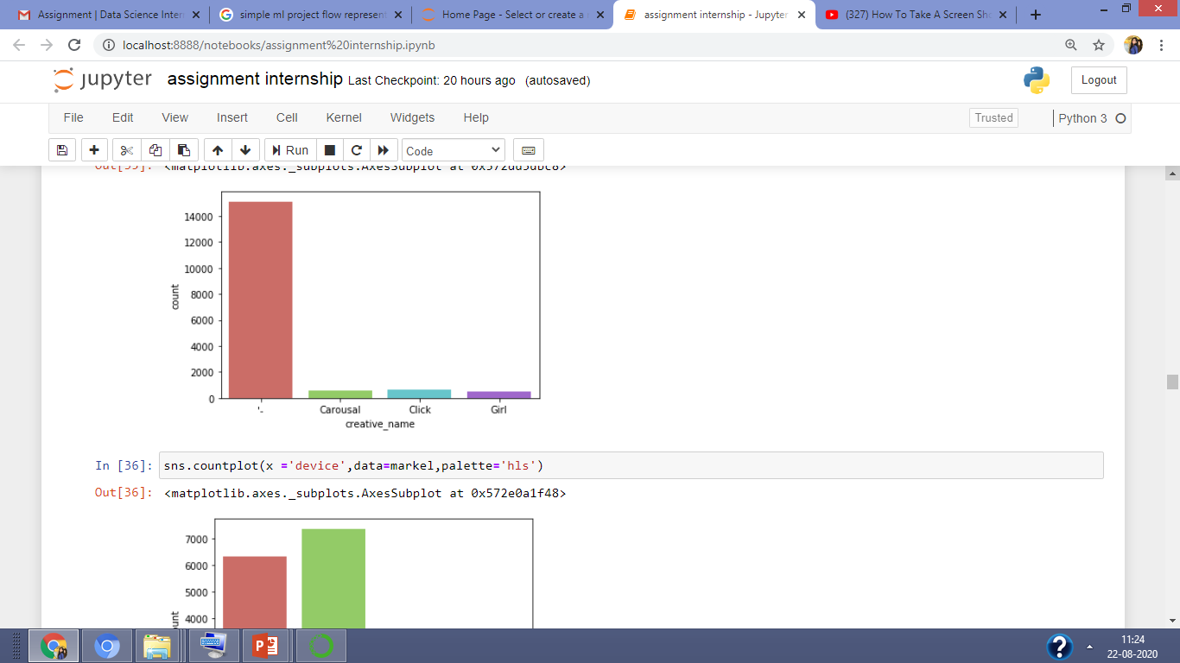
This graph represent types of creative name present in camping

Slide 15
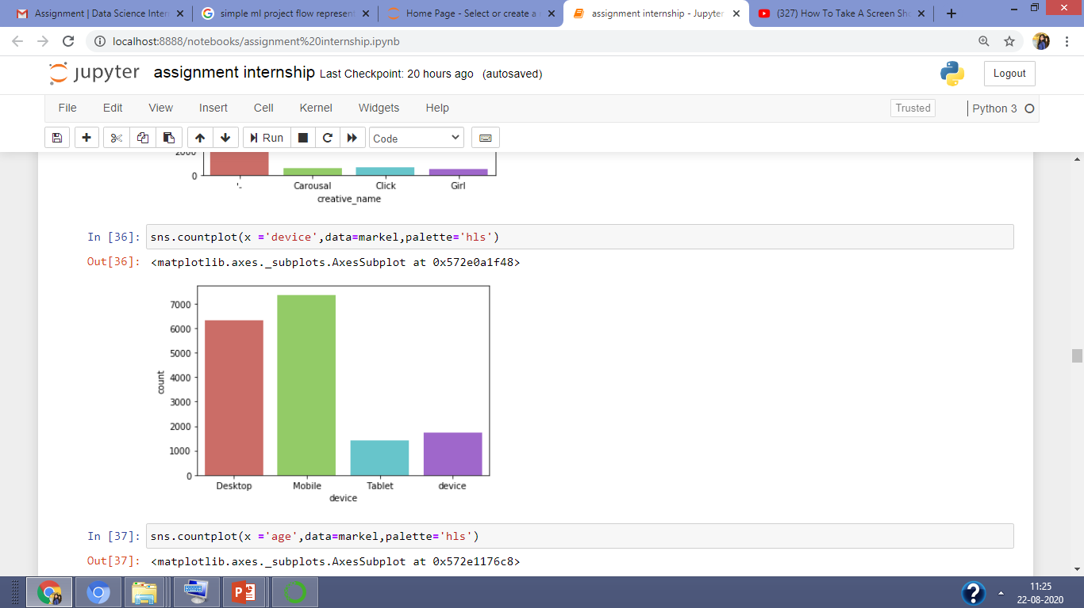
This graph represent type of device used by people

Slide 16
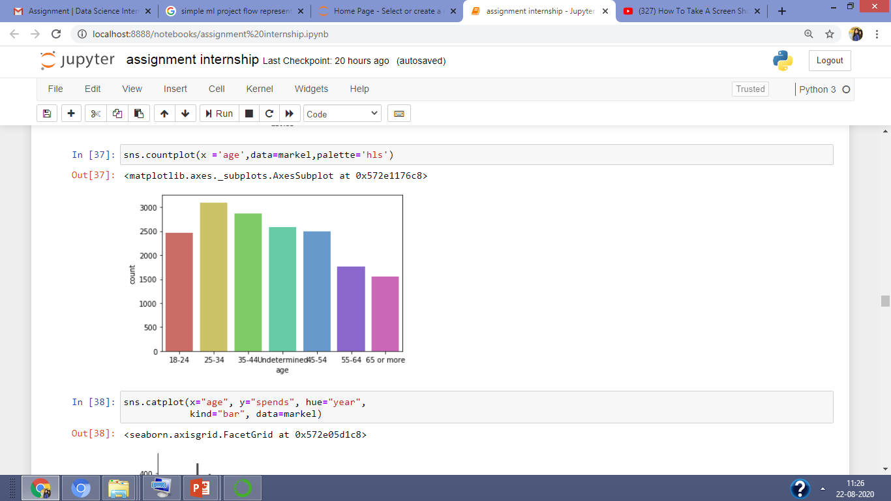
This represent the type of age group people information collected through camping

Slide 17
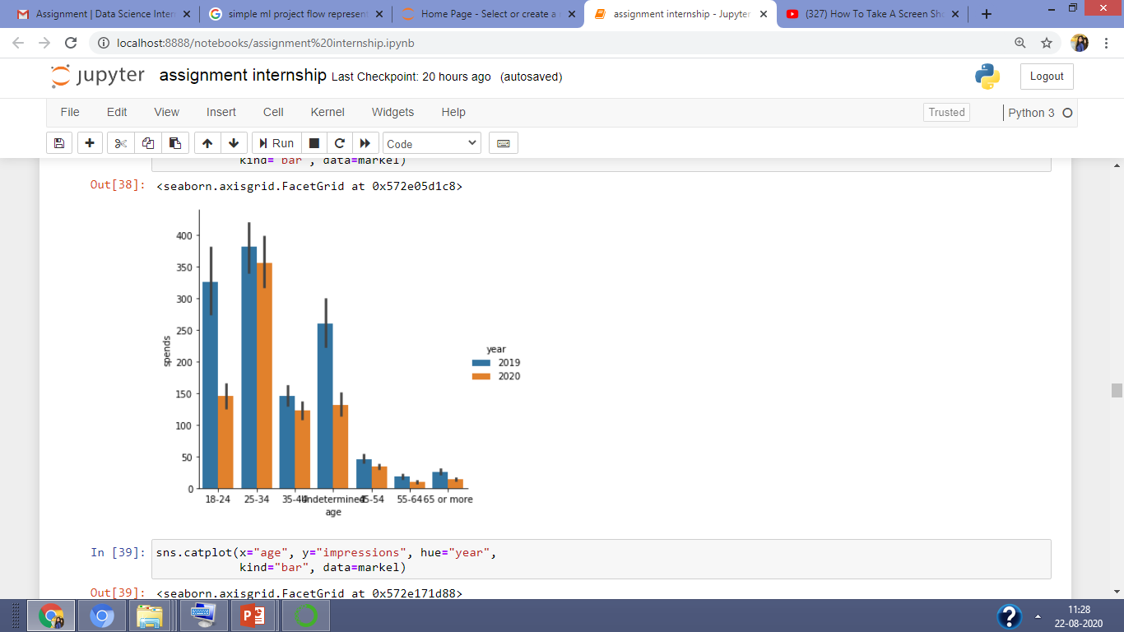
We can analyse from this graph which age group people spends more time or invest in camping from 2019 to 2020. we can easily recognize that 25-34 age group people spend more compare than other age group.

Slide 18
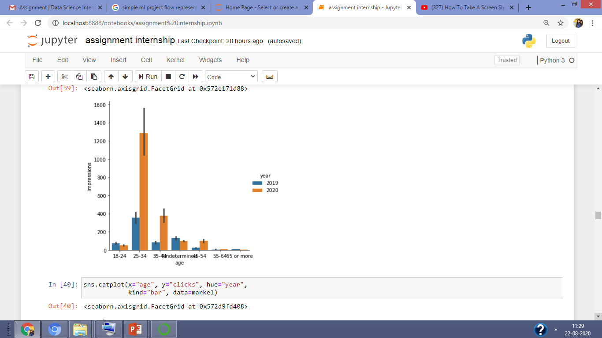
We can analyse from this graph impressions of different age group people camping from 2019 to 2020. we can easily recognize that 25-34 age group people impression is more compare than other age group

Slide 19
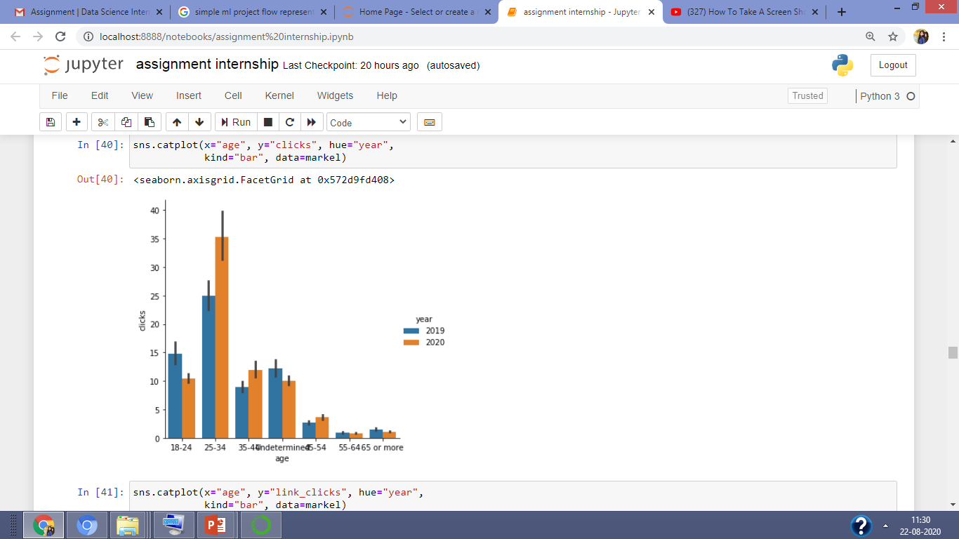
We can analyse from this graph that clicks of different age group people camping from 2019 to 2020. we can easily recognize that 25-34 age group people clicks more compare than other age group

Slide 20
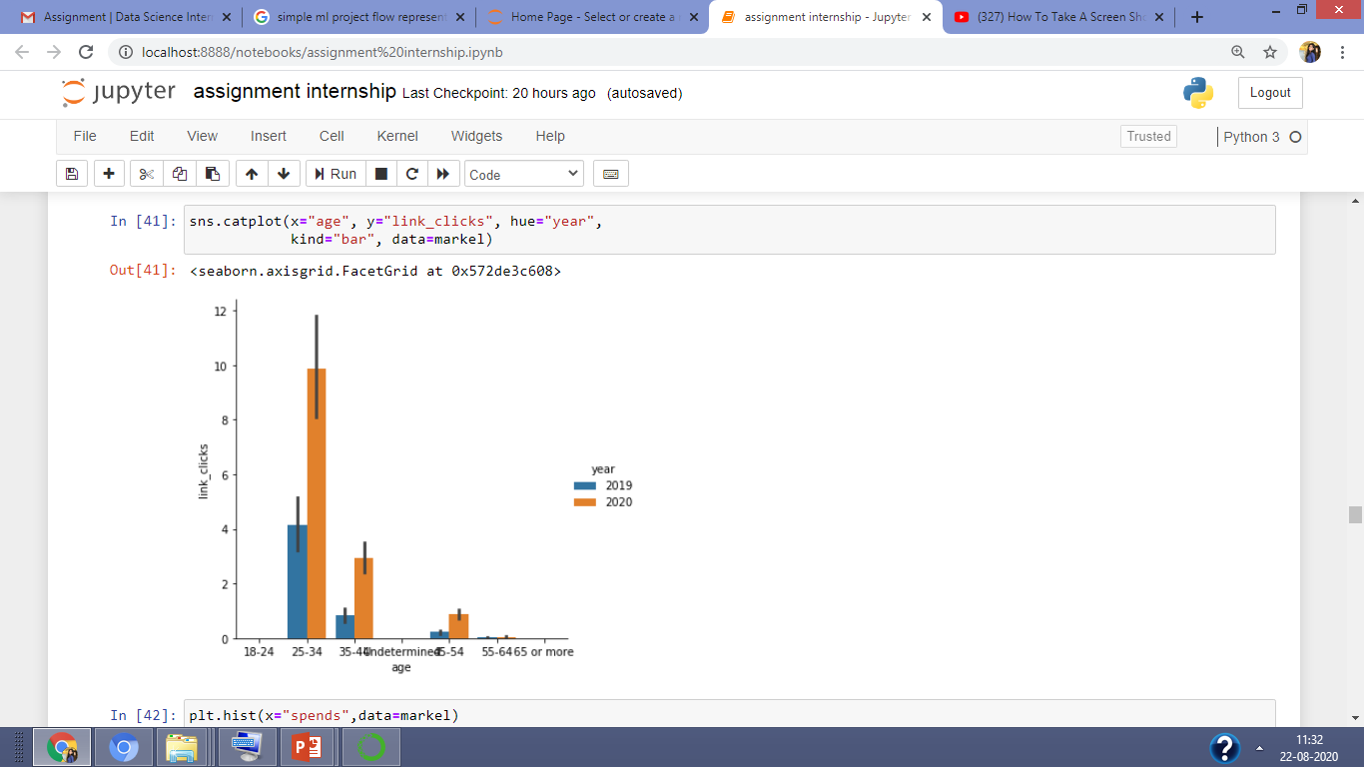
We can analyse from this graph that link_clicks of different age group people camping from 2019 to 2020. we can easily recognize that 25-34 age group people link_clicks more compare than other age group

Slide 21
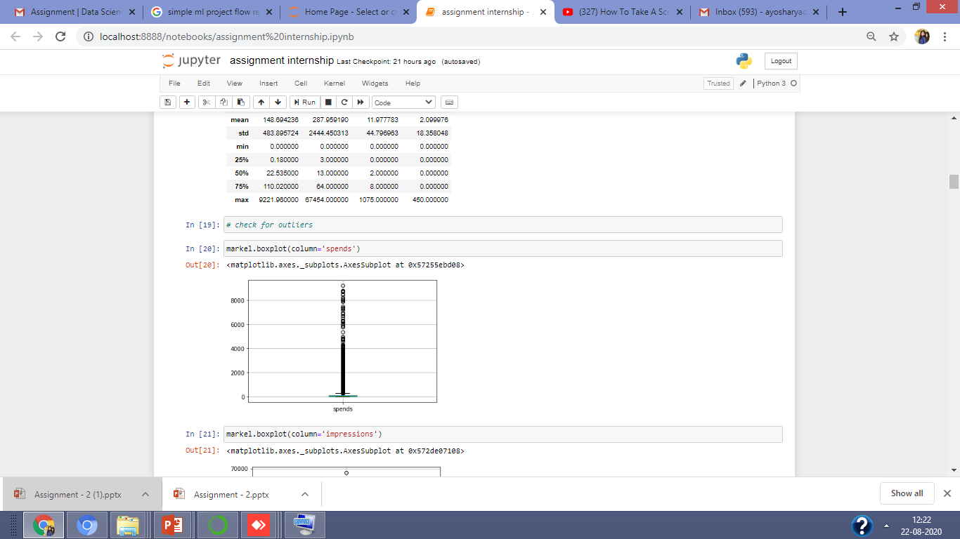
From this graph we ca see some outlies present spends

Slide 22
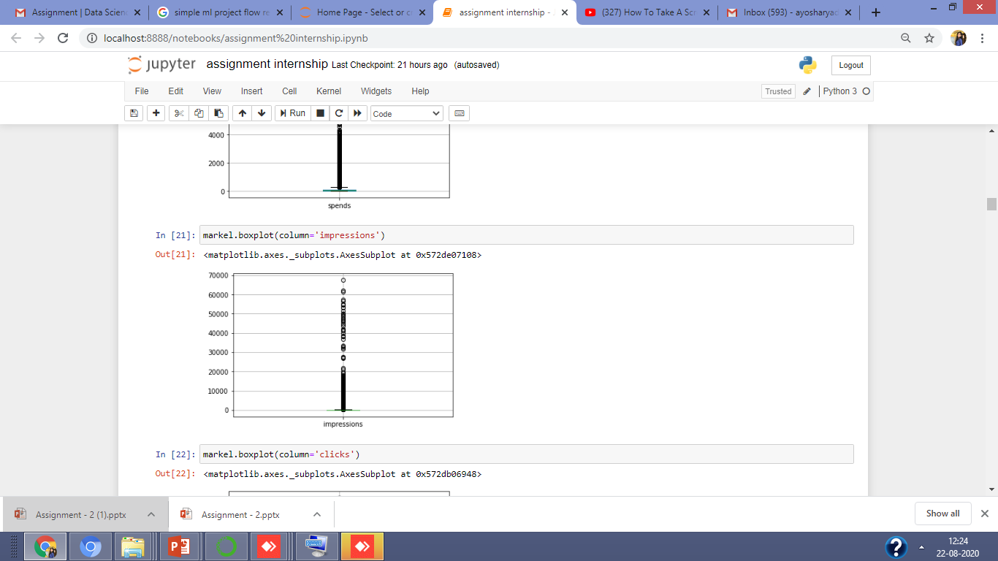
From this graph we ca see some outlies present impressions

Slide 23
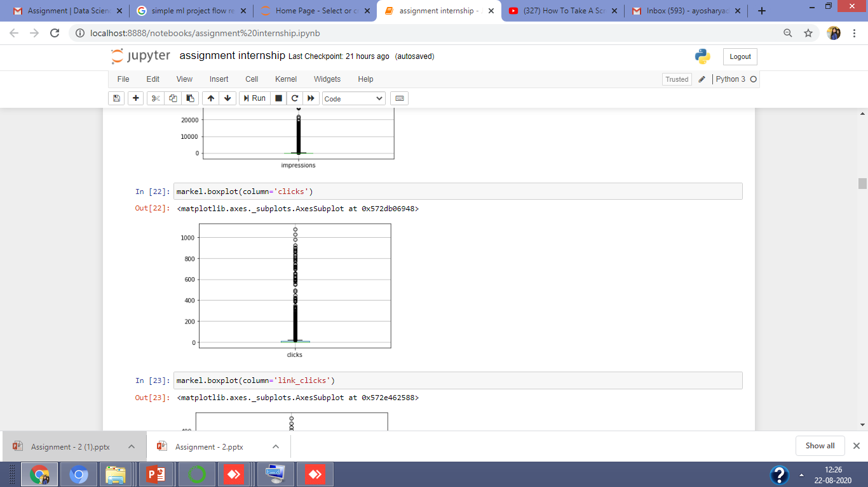
From this graph we ca see some outlies present clicks

Slide 24
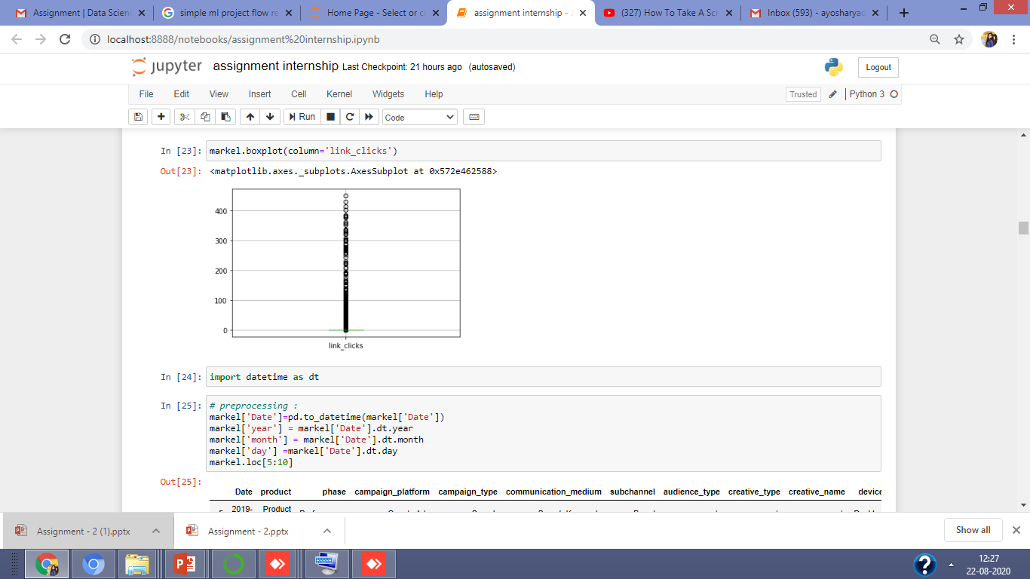
From this graph we ca see some outlies present link_clicks

Slide 25
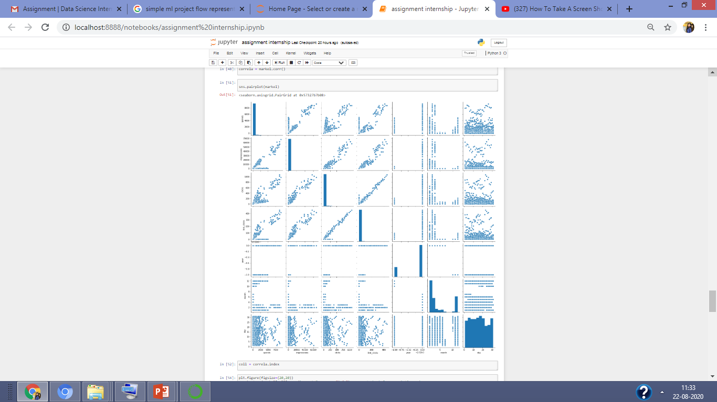
This graph represent the relationship of different input data with each other and with target variable

